Slide 1
Financial Data Analysis
Shreya Gupta​

Slide 2
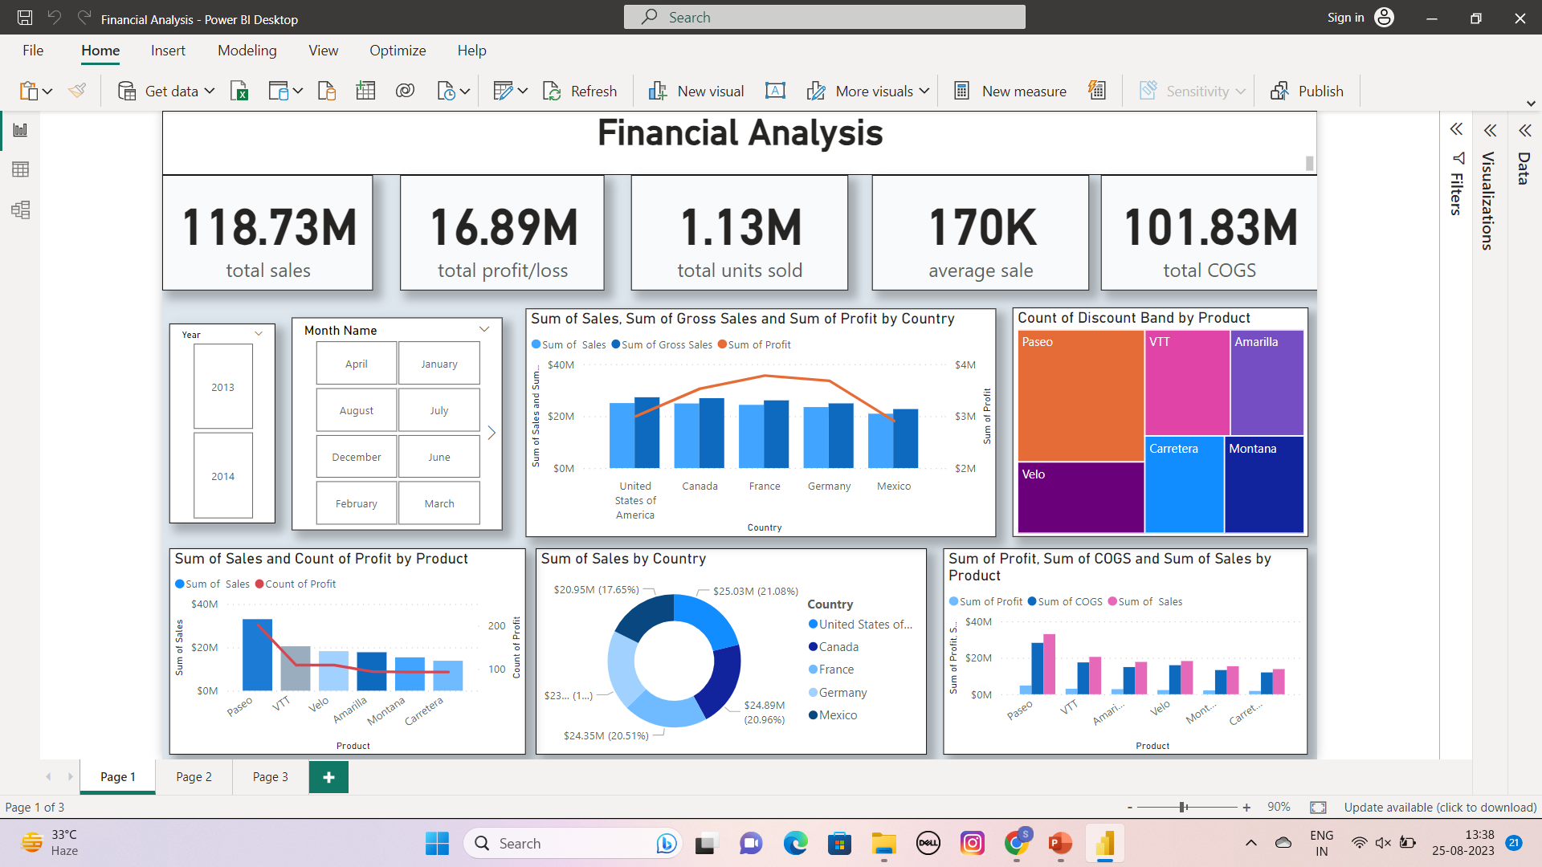

Slide 3
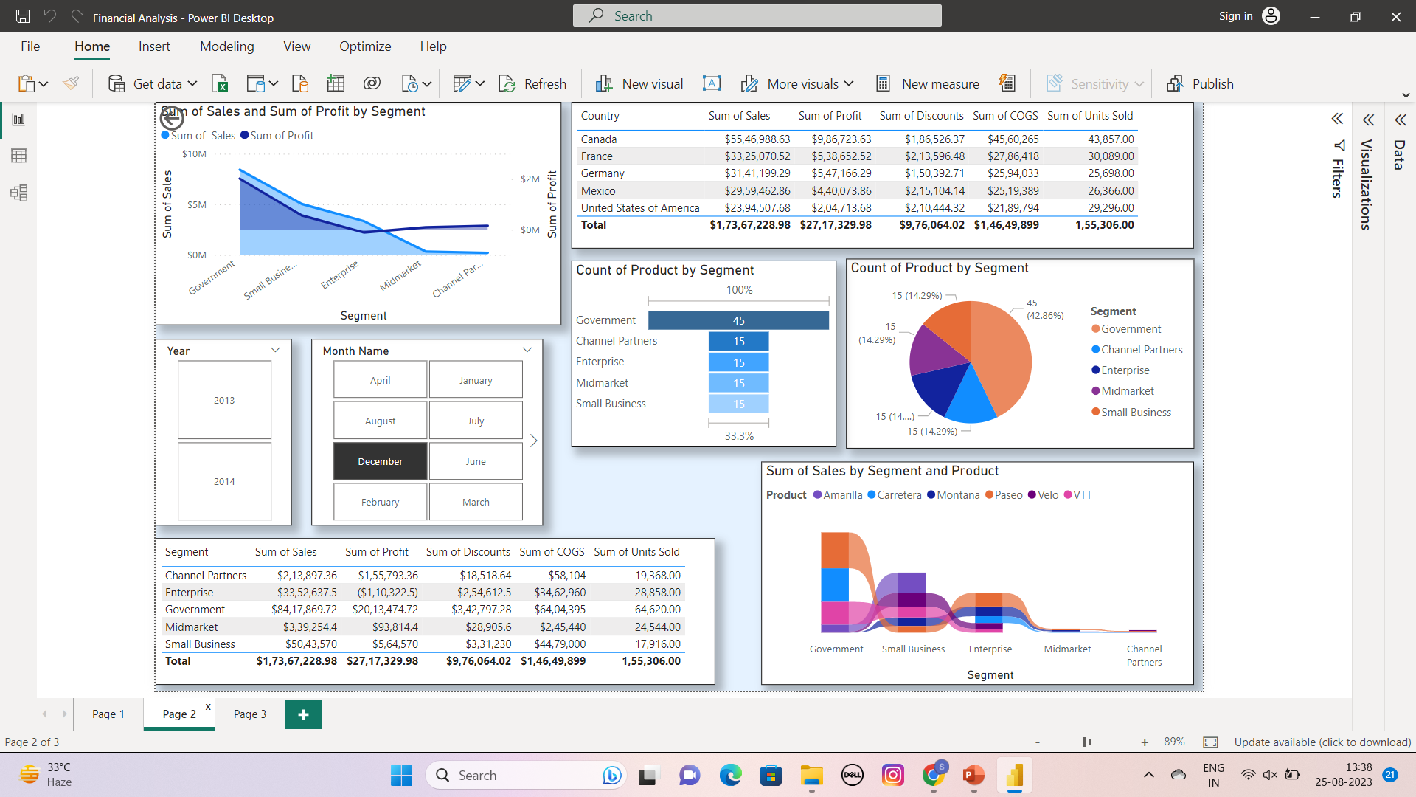

Slide 4
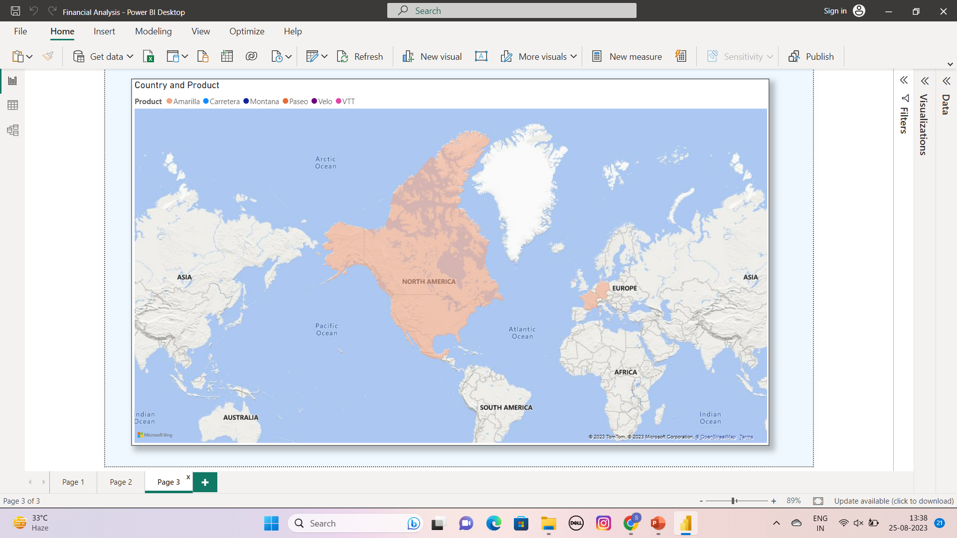

Slide 5
Summary
This project centers on leveraging Microsoft Power BI, a robust business intelligence tool, to comprehensively analyze financial data. By integrating various financial data sources, the project entails creating insightful visualizations, conducting trend analysis, and generating key performance indicators. This initiative aims to provide actionable insights for informed financial decision-making, budget planning, and performance monitoring, ultimately fostering improved financial management and strategic allocation of resources.

Slide 6
Thank you
Shreya Gupta
shreya2821gupta@gmail.com

